Slide 1
Least Squares
AMSC/CMSC 460
Dr. Christopher Moakler

Slide 2
Review from last lecture
We first looked at extending our Unshifted QR algorithm to the shifted QR algorithm.
We did this to replace the matrix A with a transformed matrix that had the same eigenvalues but is in the real Schur form.
This let us easily compute the eigenvalues.
That only works for some matrices so we had to extend our method to work for any arbitrary method.
We did this by first putting a matrix into Upper Hessenberg form by using Householder Rotators.
After putting a matrix into an Upper Hessenberg form, we can apply the Improved Shifted QR Algorithm to find the eigenvalues.

Slide 3
Review from last lecture part 2
We switched gears to looking at inconsistent systems of equations
This happens when our system has no solution which often occurs if we have more equations than unknowns.
We can not hope to find a solution for these systems because none exist.
We can instead try to find an equation that is in a sense “closest” to the “true” answer.
We looked at one way of doing this using Normal Equations

Slide 4
Normal Equations and what it means to be close
For a system of inconsistent equations,
$$Ax=b$$
we can find the solution that is closest to a “true answer” by solving the normal equations,
$$A^{T}A\overline{x}=A^{T}b$$
The solution of this new system minimizes the residual, $\left|Ax−b\right|$.
This solution minimizes the residual because the shortest
distance between a point $b$ and a plane is the
orthogonal line segment from the point to the plane.
In this case, that orthogonal distance is $\left|Ax−b\right|$.
Sauer

Slide 5
Normal Equations Example
Recall from last time,
$$x_{1}+x_{2}=2$$
$$x_{1}−x_{2}=1$$
$$x_{1}+x_{2}=3$$
We can rewrite this in matrix form,
$$\left[\begin{matrix}1 & 1 \\ 1 & −1 \\ 1 & 1\end{matrix}\right]\left[\begin{matrix}x_{1} \\ x_{2}\end{matrix}\right]=\left[\begin{matrix}2 \\ 1 \\ 3\end{matrix}\right]$$
To solve this, we need to form the matrix,
$$A^{T}A=\left[\begin{matrix}1 & 1 & 1 \\ 1 & −1 & 1\end{matrix}\right]\left[\begin{matrix}1 & 1 \\ 1 & −1 \\ 1 & 1\end{matrix}\right]=\left[\begin{matrix}3 & 1 \\ 1 & 3\end{matrix}\right]$$
We also need
$$A^{T}b=\left[\begin{matrix}1 & 1 & 1 \\ 1 & −1 & 1\end{matrix}\right]\left[\begin{matrix}2 \\ 1 \\ 3\end{matrix}\right]=\left[\begin{matrix}6 \\ 4\end{matrix}\right]$$

Slide 6
Normal Equations Example contd
We now need to solve the new system,
$$\left[\begin{matrix}3 & 1 \\ 1 & 3\end{matrix}\right]\left[\begin{matrix}\overline{x_{1}} \\ \overline{x_{2}}\end{matrix}\right]=\left[\begin{matrix}6 \\ 4\end{matrix}\right]$$
We can solve this using Gaussian Elimination
$$\left[\begin{matrix}3 & 1 \\ 0 & 8/3\end{matrix}\right]\left[\begin{matrix}\overline{x_{1}} \\ \overline{x_{2}}\end{matrix}\right]=\left[\begin{matrix}6 \\ 2\end{matrix}\right]$$
Thus, the least square solution is,
$$\overline{x}=\left[\begin{matrix}\overline{x_{1}} \\ \overline{x_{2}}\end{matrix}\right]=\left[\begin{matrix}7/4 \\ 3/4\end{matrix}\right]$$
How close are we?
$$\left[\begin{matrix}1 & 1 \\ 1 & −1 \\ 1 & 1\end{matrix}\right]\left[\begin{matrix}7/4 \\ 3/4\end{matrix}\right]=\left[\begin{matrix}2.5 \\ 1 \\ 2.5\end{matrix}\right]≠\left[\begin{matrix}2 \\ 1 \\ 3\end{matrix}\right]$$

Slide 7
Measuring the residual
As expected, our answer isn’t exact.
But how far off is it?
To measure this, we’ll look at the residual,
$$r=b−A\overline{x}$$
$r=$ $\left[\begin{matrix}2 \\ 1 \\ 3\end{matrix}\right]−\left[\begin{matrix}2.5 \\ 1 \\ 2.5\end{matrix}\right]=\left[\begin{matrix}−0.5 \\ 0 \\ 0.5\end{matrix}\right]$
I’ve been talking about minimizing the residual, but it’s clearly a vector.
So, what do I mean by “minimizing” the vector?

Slide 8
Who are you calling square?!
There are several ways to measure the size of the residual.
The most obvious one is the Euclidean length of the vector, also known as the 2-norm.
$${\left\|r\right\|}_{2}=\sqrt{r_{1}^{2}+r_{2}^{2}+…+r_{m}^{2}}$$
Sometimes working with the square root is annoying, so we instead look at the Squared Error
$$Squared Error=r_{1}^{2}+r_{2}^{2}+…+r_{m}^{2}$$
There is, finally, the root mean square error,
$$RMS Error= \sqrt{\frac{Squared Error}{m}}=\sqrt{\frac{r_{1}^{2}+r_{2}^{2}+…+r_{m}^{2}}{m}}$$
These are related by,
$$RMS Error=\sqrt{\frac{Squared Error}{m}}=\frac{{\left\|r\right\|}_{2}}{\sqrt{m}}$$

Slide 9
Normal Equations Example cont
Returning to our previous example, we have the residual vector
$r=$ $\left[\begin{matrix}2 \\ 1 \\ 3\end{matrix}\right]−\left[\begin{matrix}2.5 \\ 1 \\ 2.5\end{matrix}\right]=\left[\begin{matrix}−0.5 \\ 0 \\ 0.5\end{matrix}\right]$
We can now calculate the 3 different measure of the error.
Squared Error $={0.5}^{2}+0^{2}+{0.5}^{2}=0.5$
${\left\|r\right\|}_{2}=\sqrt{.25+0+.25}= \sqrt{0.5}≈0.707$
RMS Error =$\frac{{\left\|r\right\|}_{2}}{\sqrt{m}}=\sqrt{{0.5}/3}≈0.408$
These measures of the error are all different.
But the least squares solution minimizes all three of them.

Slide 10
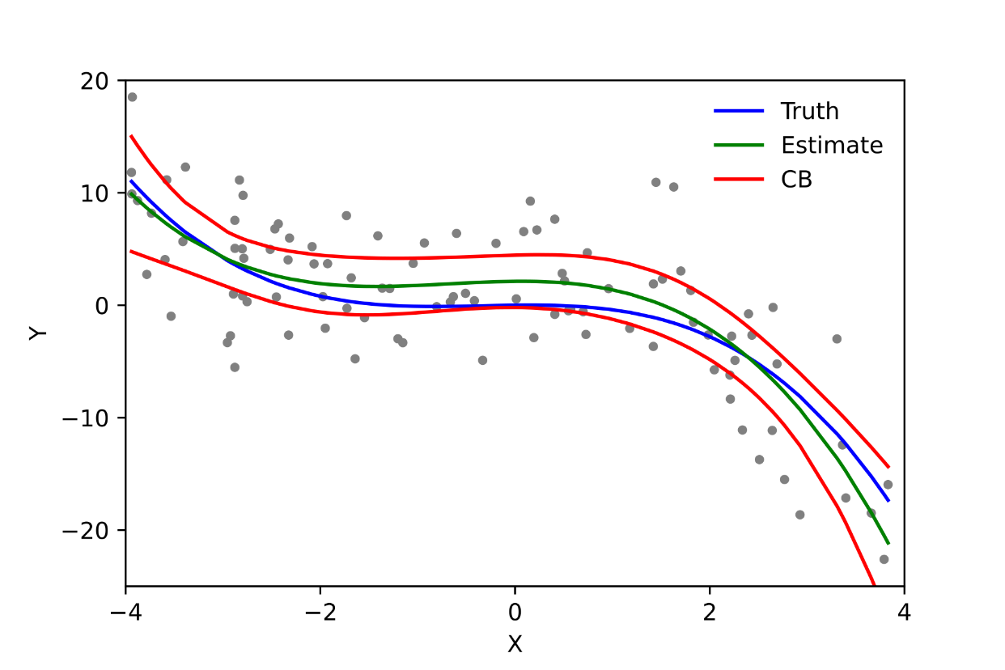
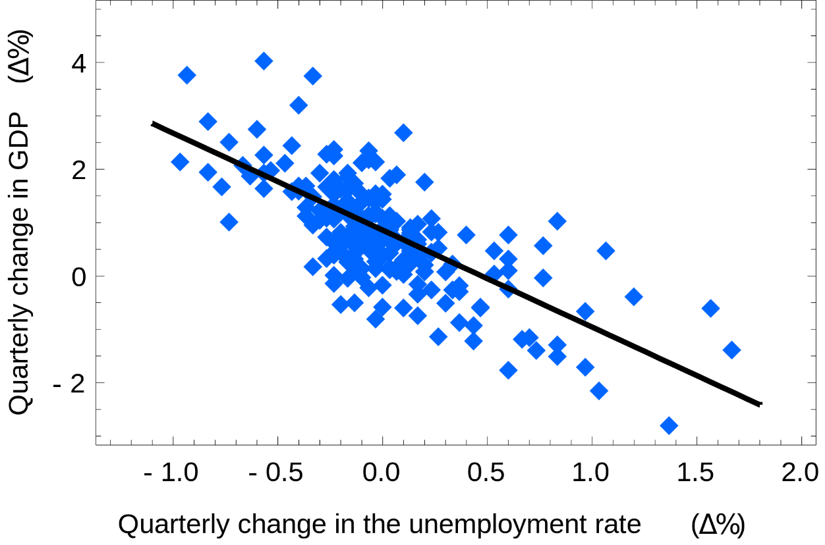
Fitting a model to data
Least squares can be used to solve inconsistent systems of linear equations.
It can also be used to fit “models” to data points.
Here, a model means a class of equations, say linear equations, that we wish to use to approximate some data we have collected.
We might instead consider a quadratic model or a sinusoidal model.
https://en.wikipedia.org/wiki/Linear_regression#/media/File:Polyreg_scheffe.svg
https://en.wikipedia.org/wiki/Simple_linear_regression#/media/File:Okuns_law_quarterly_differences.svg

Slide 11
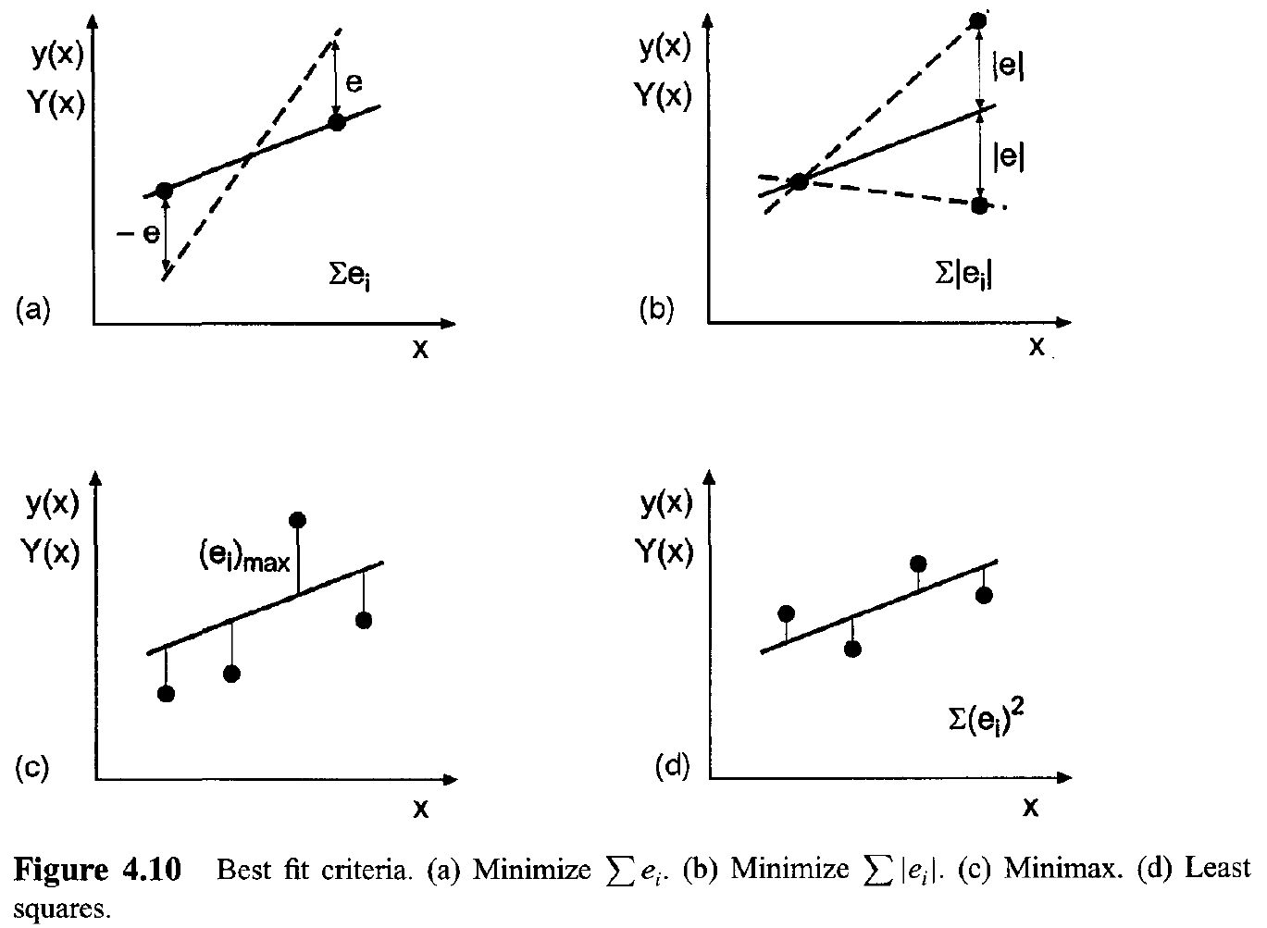
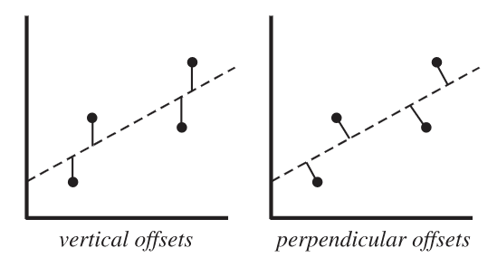
Least Squares Fitting
The least squares fitting, again, minimizes the squared residuals of the model we are fitting.
This is not the only way to fit a model to data.
The least squares method is typically the best
choice for the best fit criterion.
We could also look at “perpendicular offsets”
but it makes the analysis more complicated.
Hoffman

Slide 12
Least Squares Fitting example
Say we want to fit a linear model to the three points (1,2), (-1,1), and (1,3).
It’s obvious that these three points are not co-linear.
Thus, no linear equation can exactly fit all three data points.
Our linear model can be written as, $y=c_{1}+c_{2}x$
Applying this model to our three data points yields a system of equations:
$c_{1}+c_{2}∗\left(1\right)=2$
$c_{1}+c_{2}∗\left(−1\right)=1$
$c_{1}+c_{2}∗\left(1\right)=3$
Does this look familiar?

Slide 13
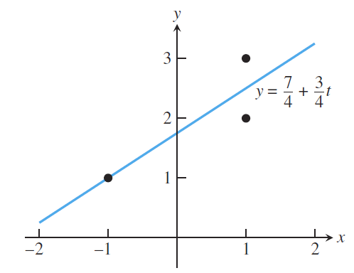
Least Squares Fitting example
Writing this in matrix form might make it more obvious,
$$\left[\begin{matrix}1 & 1 \\ 1 & −1 \\ 1 & 1\end{matrix}\right]\left[\begin{matrix}c_{1} \\ c_{2}\end{matrix}\right]=\left[\begin{matrix}2 \\ 1 \\ 3\end{matrix}\right]$$
We know the solution to this system of equations and thus, we know the best linear fit for this set of data.
Sauer

Slide 14
Fitting Data by Least Squares
We can now write down a general way to fit a model to data that minimizes the sum of the square residuals.
Given a set of data points:
Pick a model to fit the data with
For example a linear model $y=c_{1}+c_{2}x$
Plug your data points into the model and form a system of equations which are potentially inconsistent, $Ax=b$
Solve this system of equations using the normal equations.
$A^{T}A\overline{x}=A^{T}b$

Slide 15
Another Example
Let’s look at another example.
Let’s find the best fit line for the data points:
(-1,1), (0,0), (1,0), and (2,-2).
Our model will be of the form $y=c_{1}+c_{2}x$
Thus, our system is
$c_{1}+c_{2}∗\left(−1\right)=1$
$c_{1}−c_{2}∗\left(0\right)=0$
$c_{1}+c_{2}∗\left(1\right)=0$
$c_{1}+c_{2}∗\left(2\right)=−2$

Slide 16
Another Example contd
Putting it in the familiar matrix form gives us
$$\left[\begin{matrix}1 & −1 \\ 1 & 0 \\ 1 & 1 \\ 1 & 2\end{matrix}\right]\left[\begin{matrix}c_{1} \\ c_{2}\end{matrix}\right]=\left[\begin{matrix}1 \\ 0 \\ 0 \\ −2\end{matrix}\right]$$
We need the normal equations
$$A^{T}A=\left[\begin{matrix}1 & 1 & 1 & 1 \\ −1 & 0 & 1 & 2\end{matrix}\right]\left[\begin{matrix}1 & −1 \\ 1 & 0 \\ 1 & 1 \\ 1 & 2\end{matrix}\right]=\left[\begin{matrix}4 & 2 \\ 2 & 6\end{matrix}\right]$$
$$A^{T}b=\left[\begin{matrix}−1 \\ −5\end{matrix}\right]$$
We end up with,
$$\left[\begin{matrix}4 & 2 \\ 2 & 6\end{matrix}\right]\left[\begin{matrix}c_{1} \\ c_{2}\end{matrix}\right]\text{= }\left[\begin{matrix}−1 \\ −5\end{matrix}\right]$$

Slide 17
Another Example contd
Solving the system using Gaussian Elimination we find the best fit line,
$$y=0.2−0.9x$$
This has residual vector
$$r=b−Ax=\left[\begin{matrix}−0.1 \\ −0.2 \\ 0.7 \\ −0.4\end{matrix}\right]$$
This has a Squared Error of 0.7 and RMS Error of 0.418

Slide 18
An example with a Quadratic Model
Many of you are probably very familiar with the idea of least squares and using it to get a linear best fit line.
However, we can also use least squares on other models as well!
For example, let’s apply a quadratic model to the set of 4 data points we just analyzed.
The quadratic model is,
$$y=c_{1}+c_{2}x+c_{3}x^{2}$$
We can plug in the data points from before and get a new system of equations.

Slide 19
An example with a Quadratic Model cont
The system is,
$c_{1}+c_{2}∗\left(−1\right)+c_{3}∗{\left(−1\right)}^{2}=1$
$c_{1}−c_{2}∗\left(0\right)+c_{3}∗{\left(0\right)}^{2}=0$
$c_{1}+c_{2}∗\left(1\right)+c_{3}∗{\left(0\right)}^{2}=0$
$c_{1}+c_{2}∗\left(2\right)+c_{3}∗{\left(2\right)}^{2}=−2$
In matrix form we have,
$$\left[\begin{matrix}1 & −1 & 1 \\ 1 & 0 & 0 \\ 1 & 1 & 1 \\ 1 & 2 & 4\end{matrix}\right]\left[\begin{matrix}c_{1} \\ c_{2} \\ c_{3}\end{matrix}\right]=\left[\begin{matrix}1 \\ 0 \\ 0 \\ −2\end{matrix}\right]$$

Slide 20
An Example with a Quadratic Model cont
The normal equations are,
$$\left[\begin{matrix}4 & 2 & 6 \\ 2 & 6 & 8 \\ 6 & 8 & 18\end{matrix}\right]\left[\begin{matrix}c_{1} \\ c_{2} \\ c_{3}\end{matrix}\right]=\left[\begin{matrix}−1 \\ −5 \\ −7\end{matrix}\right]$$
And the solution is, $y=0.45−0.65x−0.25x^{2}$
The residual vector is
$$r=b−Ax=\left[\begin{matrix}0.15 \\ −0.45 \\ 0.45 \\ −0.15\end{matrix}\right]$$
This has a Squared Error of 0.45 and RMS Error of 0.335

Slide 21
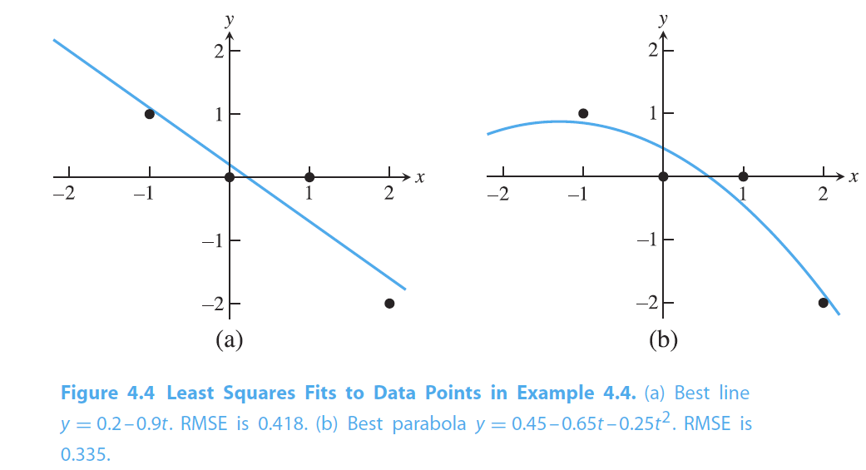
Comparing the models
Sauer
Which do you think is better and why?

Slide 22
How to pick a model
We often have data that may not be well suited for a linear model.
I am being purposefully vague when I say “well suited”
By “linearizing” our data, we can fit various sorts of models to our data.
I’ll return to this in a moment.
But the question remains, how do we make a choice about what model to pick?
It is very tempting to say that we should take the model with the lowest RMS error, but this isn’t always the best idea.
We should think about the sort of relationship we expect in the underlying data and the constraints our data should abide by.

Slide 23
Data Linearization
We can use our method of least squares on any model that is linear in the coefficients.
Clearly, we can choose any polynomial and those coefficients are all linear.
We can also use a sinusoidal model with linear coefficients, for example,
$$c_{1}+c_{2}\cos\left(2πx\right)+c_{3}sin⁡(2πx)$$
What if we suspect our underlying model should be an exponential?
That is,
$$y=c_{1}e^{c_{2}x}$$
Well, the second coefficient is no longer linear here.
Can we fix this?

Slide 24
Can we fix it? Yes, we can!
To linearize this model, we take the logarithm of both sides,
$$y=c_{1}e^{c_{2}x}$$
$$\ln\left(y\right)=\ln\left(c_{1}\right)+c_{2}x$$
Technically the first coefficient is no longer linear here, but we can just reassign that whole term and get,
$$\ln\left(y\right)=k+c_{2}x$$
where I have made the substitution $k=\ln\left(c_{1}\right)$
When forming the system of equations for this model, we should remember to take the logarithm of the y-values.

Slide 25
Power model
We also frequently see data that we suspect has an underlying power law relationship.
That is,
$$y=c_{1}x^{c_{2}}$$
This can also be linearized by taking the logarithm,
$$\ln\left(y\right)=\ln\left(c_{1}\right)+c_{2}\ln\left(x\right)$$
We make the same substitution as before and we get,
$$\ln\left(y\right)=k+c_{2}ln⁡(x)$$

Slide 26
Least Square Conditioning
When performing a least squares fit with the normal equations, we must perform Gaussian Elimination on the matrix $A^{T}A$.
Thus, the conditioning of this approach is $cond(A^{T}A)$.
This is about the square of the original condition number of the matrix $A$.
It is very easy to find yourself with an ill-conditioned matrix and data that derives from a very messy source!
Think of an underpaid grad student trying to weigh birds on a rainy day.
Or a junior researcher tasked with counting cells on a petri dish.
We can perform a least squares fit without ever forming the matrix $A^{T}A$ and thus avoid that large condition number.
To do this we’ll return to QR factorization

Slide 27
Least Squares by QR Factorization
We’ve already reviewed the QR factorization obtained via Gram-Schmidt Orthogonalization, so I’ll jump right to the application.
Given an inconsistent system,
$$Ax=b$$
Find the QR factorization $A=QR$
Find $d=Q^{T}b$
Solve $R\overline{x}=d$
Instead of forming $A^{T}A$and solving a system of equations, we instead formulate a similar problem and entirely obviate the need to consider $A^{T}A$

Slide 28
QR Factorization with Householder Reflectors
We could alternatively find the QR factorization of $A$ using Householder reflectors from the last class.
This approach minimizes some of the amplification of rounding errors.
It also requires less memory.
It should be your go to method for QR factorization.

